Slide 1

Databases & SQL for Data Science with Python
PROFESSIONAL CERTIFICATE IBM Data Analyst

Slide 2
In this week!
Popular SQL APIs
Connecting Python apps to a database
How to access databases using Python
Analyze and visualize data in Jupyter Notebooks

Slide 3
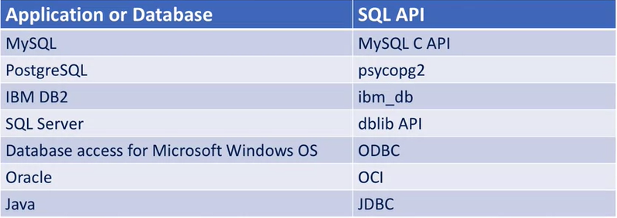
Popular SQL APIs
The application program begins its database access with one or more API calls that connect the program to the DBMS.
Notes:
an application program calls functions in the API, and it calls other functions to retrieve query results and status information from the DBMS.

Slide 4
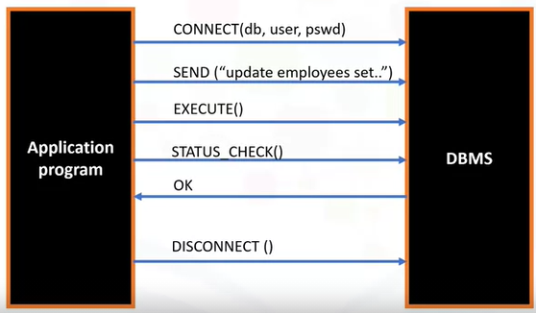
SLQ APIs library function
The SQL API consists of library function calls as an application programming interface, API, for the DBMS.
How to pass SQL statements to the DBMS?
Notes:
an application program calls functions in the API, and it calls other functions to retrieve query results and status information from the DBMS.

Slide 5
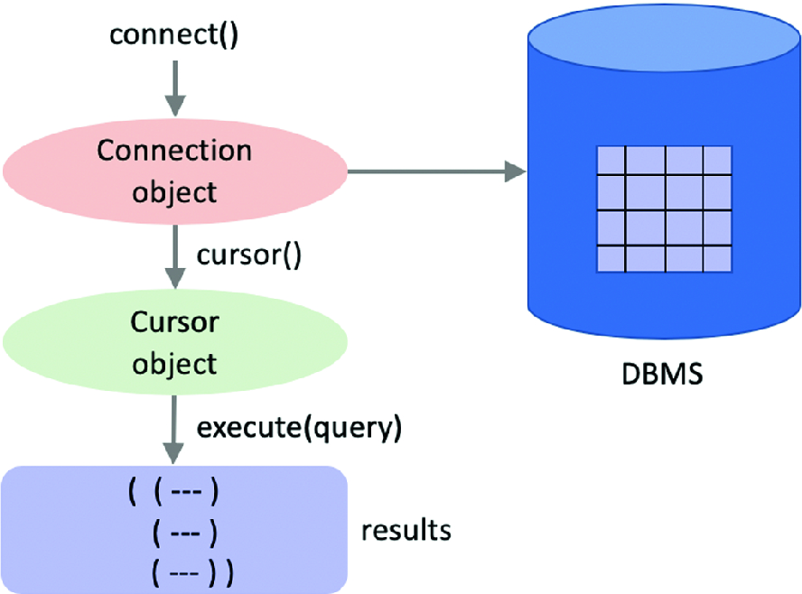

Slide 6
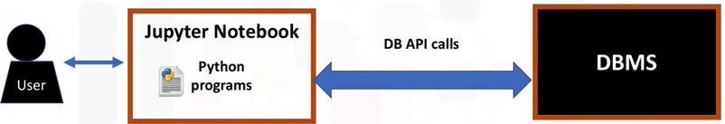
How to access databases using Python
What is Jupyter Notebook?
What is RDMS?
The Python code connects to the database using DB-API calls.
What is DB-API?
What are the benefits of using DB-API?
Notes:
the user writes Python programs using a Jupyter notebook.
There is a mechanism by which the Python code communicates with the DBMS.

Slide 7
Connecting to a Database Using ibm_db API
Describe the ibm-db API
List the credentials required to connect to a database
How to connect to an IBM DB2 database using Python code written on a Jupyter notebook?

Slide 8
Hands-on Labs
Take 50 minutes to complete Hands-on Labs on Coursera:
Create Database Credentials on Coursera
Connecting to a database instance

Slide 9
SQL Magic
What is SQL Magic?
Two types of magic commands:
Cell magics: start with a double %% sign and apply to the entire cell
Line magics: start with a single % (percent) sign and apply to a particular line in a cell
SQL Magic Limitations
Unlike DB-API, there are no explicit methods to close a connection and free up resources.
Notes:
Jupyter notebooks have a concept of Magic commands that can simplify working with Python, and are particularly useful for data analysis.

Slide 10
Example
You want to execute a query to select some data from a table and fetch its results, what can you write on Jupyter notebook cell?
%sql select * from tablename

Slide 11
Hands-on Lab
Take 30 minutes to complete the hands-on Lab on Coursera: Accessing Databases with SQL magic

Slide 12




Discuss loading data into a table steps
SOURCE
TARGET
DEFINE
FINALIZE
Notes:
What should be done in each step?

Slide 13
Connection methods
The DB_API connect constructor
cursor() method
commit() method
rollback() method
close() method

Slide 14
Connection methods
The DB_API connect constructor creates a connection to the database and returns a Connection Object, which is then used by the various connection methods.
cursor() method, which returns a new cursor object using the connection.
commit() method, which is used to commit any pending transaction to the database.
rollback() method, which causes the database to roll-back to the start of any pending transaction.
close() method, which is used to close a database connection.

Slide 15
Breakout Room Activity
How can we use Pandas to retrieve data from the database tables?
Df= pandas.read_sql(‘select * from TableName’,pconn)
List some panda’s statistical and mathematical methods
Be prepared to discuss your findings

Slide 16
Hands-on Lab
Take 45 minutes to complete the hands-on Lab on Coursera: Analyzing a real World Data Set

Slide 17
Any questions

